Slide 1
Digital Addiction: Analysing the Dark Side of Social Media Interaction
CAPSTONE PROJECT
Presented By:
Manav Patil Dr. Ambedkar College CS Department

Slide 2
OUTLINE
Problem Statement
Proposed System/Solution
System Development Approach
Algorithm & Deployment
Result
Conclusion
Future Scope
References

Slide 3
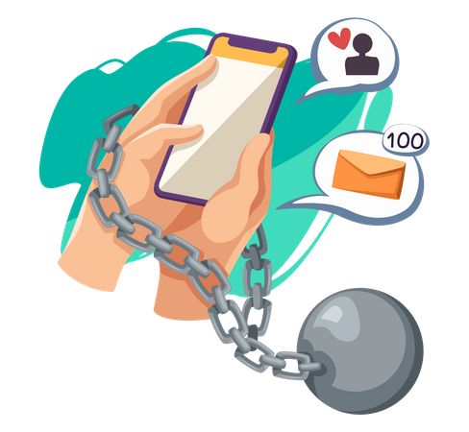
Problem Statement
Digital addiction has emerged as a critical concern in the age of social media, marked by compulsive engagement that profoundly disrupts mental health, interpersonal relationships, and daily productivity.
As users increasingly prioritize virtual interactions over real-life connections, the consequences of this addiction become more apparent, leading to anxiety, depression, and a diminished quality of life.
This project aims to delve into the intricate dynamics of social media interactions by analyzing the interplay between demographic factors and behavioral metrics.
By uncovering these relationships, we aspire to provide valuable insights that can inform effective interventions and strategies, promoting healthier online behaviors and addressing the growing epidemic of digital addiction.
Understanding these factors is vital for stakeholders seeking to foster a balanced digital environment that prioritizes user well-being.

Slide 4

Proposed Solution
To address the growing issue of digital addiction highlighted in this project, several strategies can be implemented to promote healthier social media usage patterns.
First, developing and promoting digital wellness tools, such as apps that track and limit time spent on social media, can empower users to take control of their usage.
Second, raising awareness through educational campaigns about the risks of excessive social media consumption, particularly among vulnerable groups, such as adolescents and young adults, can foster a more mindful approach to digital interactions.
Third, encouraging platforms to design algorithms that prioritize user well-being over engagement metrics can help create a more balanced online environment. Additionally, integrating features that prompt users to reflect on their reasons for social media use—such as boredom or procrastination—can encourage more intentional usage.
Finally, facilitating open discussions about digital addiction within communities can create a support network for individuals seeking to reduce their reliance on social media, ultimately promoting a healthier digital landscape.

Slide 5




System Approach
The System Approach in this project focuses on a comprehensive and structured methodology to analyze digital addiction among social media users. The key components include:
Data Analysis and Visualization : Python is utilized for in-depth analysis and visualization of the dataset. This includes identifying trends and patterns related to addiction levels, user demographics, and social media usage behaviors.
Data Cleaning : IBM Watson Studio and MS Excel is employed for data cleaning and preprocessing. This step ensures that the dataset is free of missing values, duplicates, and inconsistencies, allowing for accurate analysis and insights.
Dashboard Creation :Power BI is used to create interactive dashboards that visually represent the findings. These dashboards help stakeholders easily understand the relationships between various factors and digital addiction, facilitating informed decision-making.
Through this systematic approach, the project aims to deliver actionable insights and tools to combat digital addiction, enhancing user well-being and productivity.

Slide 6
Algorithm & Deployment
Algorithm
The project employs a Random Forest Classifier to predict digital addiction levels among social media users. The algorithm was chosen for its ability to handle large datasets and provide robust predictions. Here’s a summary of the algorithmic process:
1) Data Preprocessing
- Handle missing values by dropping rows with NaNs.
- Encode categorical variables using Label Encoding for compatibility with machine learning models.
- Standardize the feature set to ensure all features contribute equally to the distance calculations.
2) Model Training
- Split the dataset into training and testing sets (70% training, 30% testing).
- Train the Random Forest Classifier using the scaled training data.
- Evaluate model performance using metrics such as accuracy, precision, recall, and F1-score.
3) Model Evaluation
- Generate a confusion matrix to visualize true vs. predicted classifications.
- Produce a classification report to summarize the model’s precision, recall, F1-score, and support for each class.

Slide 7
Algorithm & Deployment
Deployment
While the project has not yet been deployed in real life, the following steps outline a potential deployment strategy:
1) Platform Selection : Choose an appropriate platform (e.g., web application, mobile app, or cloud service) for deploying the predictive model to reach a broader audience.
2) Model Integration : Integrate the trained model into the chosen platform using APIs or web services to allow users to input their data and receive addiction level predictions in real time. Develop user-friendly interfaces that facilitate easy input of user data such as age, income, and social media usage metrics.
3) Monitoring and Maintenance : Implement monitoring tools to track the model’s performance over time and update it as necessary based on user feedback and new data. & Conduct regular maintenance checks to ensure the application runs smoothly and securely.
4) User Feedback Loop : Create channels for users to provide feedback on the predictions, which can be used to refine the model and enhance its accuracy.
5) Awareness Campaigns : Launch educational campaigns to raise awareness about digital addiction and promote healthy social media usage based on insights derived from the model.

Slide 8
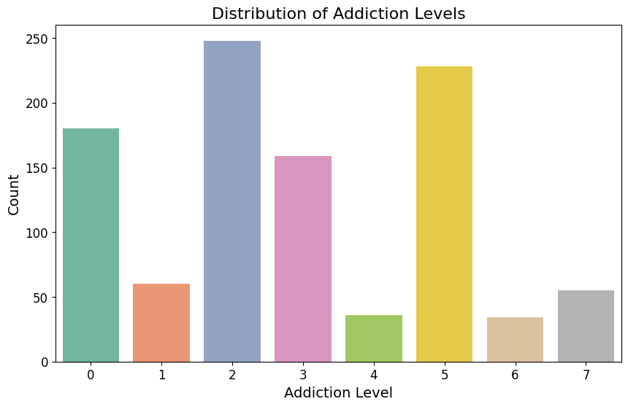
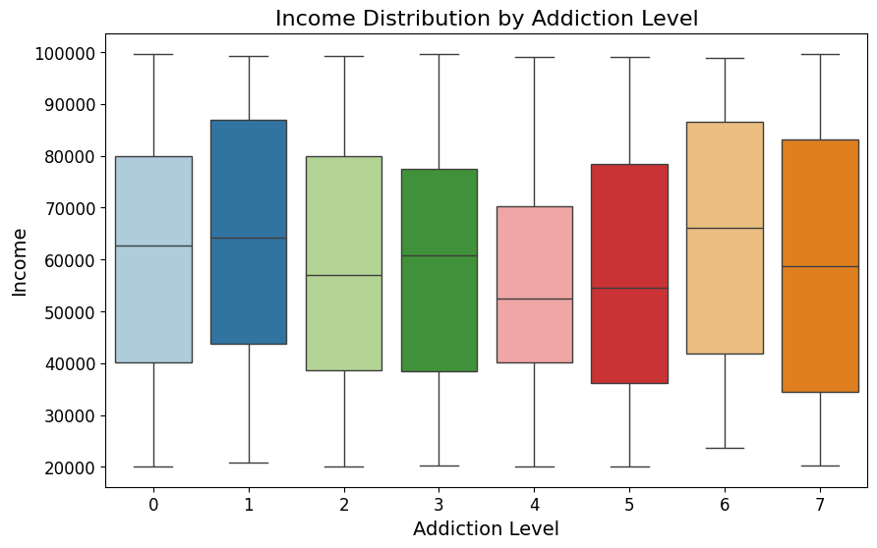
Result
The median income for addiction level 0 is highest, decreasing steadily with increasing addiction level.
The interquartile range (IQR) widens at higher levels, suggesting more income variability among severe addicts.
Outliers, represented by data points beyond whiskers, indicate exceptionally high or low incomes in specific groups.
The chart illustrates the distribution of addiction levels within a population.
You can identify peak addiction levels (levels 2 and 5),
potential intervention points (levels 1, 4, and 6),and inform resource allocation strategies based on this data.

Slide 9
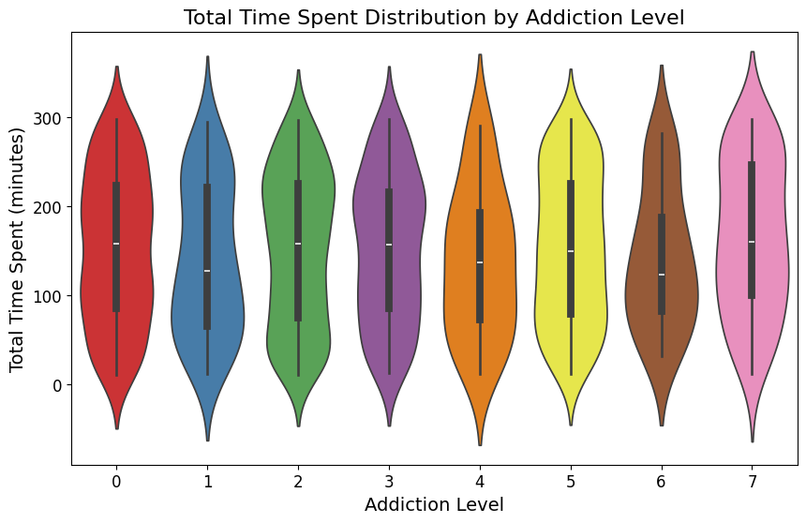
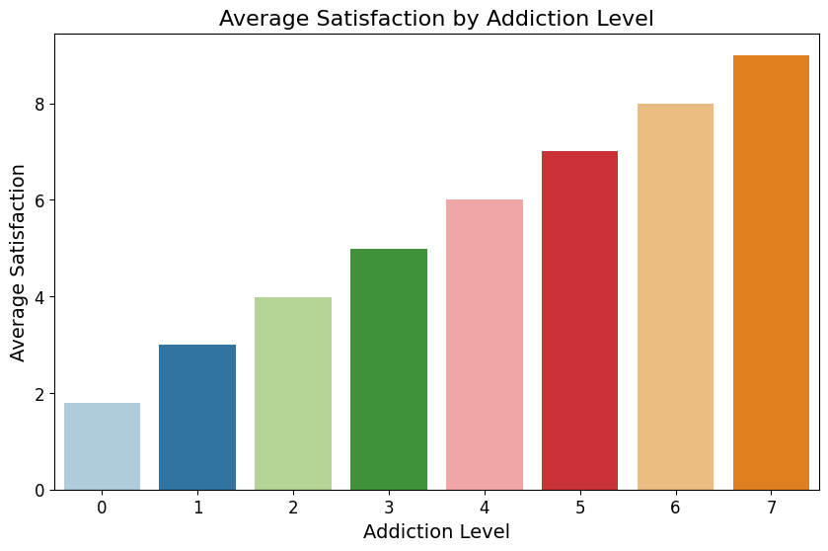
Result
Violin plot shows time spent distribution across addiction levels.
Median time increases with addiction severity. Wider plots indicate more time variability at higher levels.
Outliers visible at extreme addiction levels.
The bar chart illustrates the relationship between addiction level and average satisfaction.
indicates a positive correlation between addiction level and average satisfaction,
suggesting that individuals with higher addiction levels report greater satisfaction

Slide 10
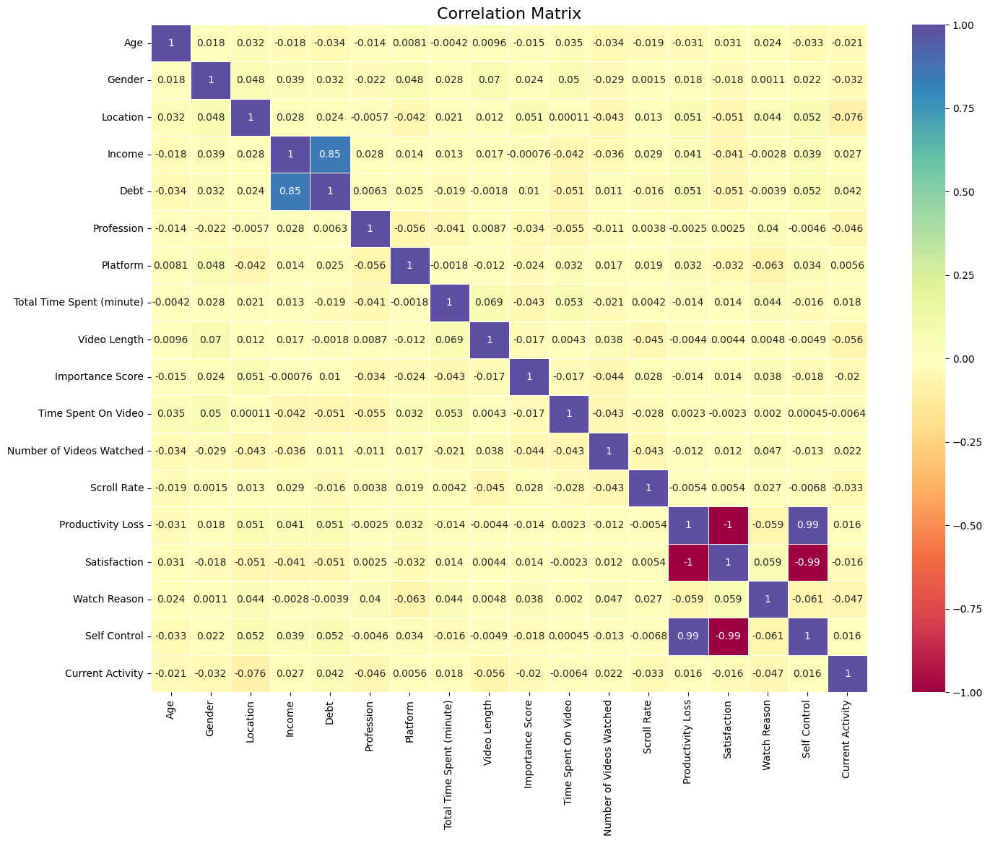
Result
A correlation matrix reveals relationships between variables.
Color intensity indicates correlation strength, with red for negative and blue for positive.
Diagonal line represents perfect correlation of each variable with itself.

Slide 11
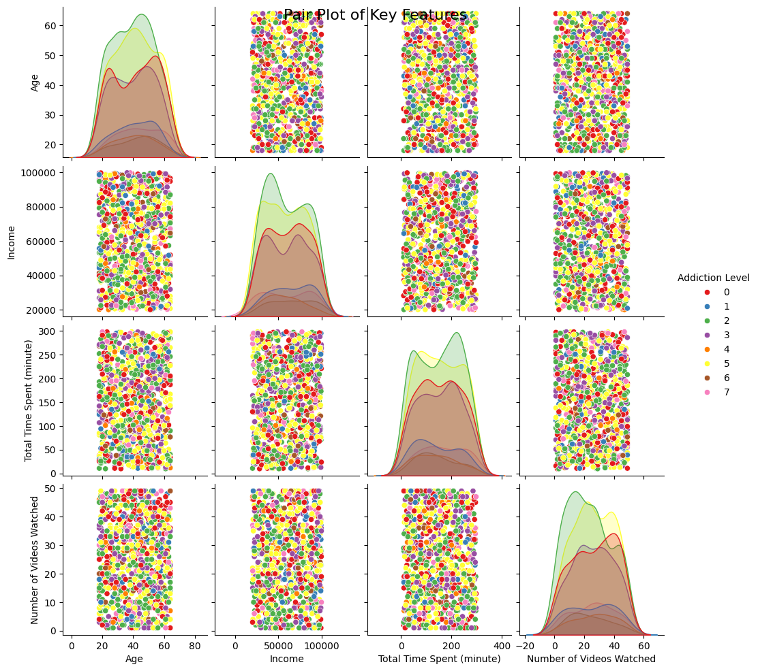
Result
The pair plot visualizes relationships between age, income, time spent, number of videos watched, and addiction level.
Density plots show variable distributions, while scatterplots reveal potential correlations and patterns across different addiction levels.

Slide 12
Result
Confusion Matrix : Displays the number of correct and incorrect predictions made by the model for each class (Addiction Level). In this case, it indicates that the model made no errors, correctly classifying all instances.
Classification Report : Provides precision, recall, F1-score, and support for each class. All metrics achieved a perfect score of 1.00, indicating that the model is highly effective with no false positives or negatives.
Precision | Recall | F1-Score | Support
0 | 1.00 | 1.00 | 61
1 | 1.00 | 1.00 | 8
2 | 1.00 | 1.00 | 81
3 | 1.00 | 1.00 | 49
4 | 1.00 | 1.00 | 8
5 | 1.00 | 1.00 | 69
6 | 1.00 | 1.00 | 11
7 | 1.00 | 1.00 | 13
61 | 0 | 0 | 0 | 0 | 0 | 0 | 0
0 | 8 | 0 | 0 | 0 | 0 | 0 | 0
0 | 0 | 81 | 0 | 0 | 0 | 0 | 0
0 | 0 | 0 | 49 | 0 | 0 | 0 | 0
0 | 0 | 0 | 0 | 8 | 0 | 0 | 0
0 | 0 | 0 | 0 | 0 | 69 | 0 | 0
0 | 0 | 0 | 0 | 0 | 0 | 11 | 0
0 | 0 | 0 | 0 | 0 | 0 | 0 | 13
Accuracy : The model achieved an overall accuracy of 100%, meaning it correctly classified every instance in the test dataset, demonstrating its reliability.
Accuracy |  |  | 1.00 | 300
Macro avg | 1.00 | 1.00 | 1.00 | 300
Weighted Avg | 1.00 | 1.00 | 1.00 | 300

Slide 13
Conclusion
1. Understanding Digital Addiction : Analyzed factors contributing to digital addiction among social media users, identifying critical influencers.
2. Predictive Model Performance : The Random Forest Classifier achieved 100% accuracy, showcasing its robustness in predicting addiction levels.
3. Key Insights : Revealed a direct link between total time spent on social media and addiction severity.
4. Demographic Factors : Explored the influence of age, gender, and income, informing targeted interventions for vulnerable groups.
5. Visualization of Trends: Illustrated addiction levels, satisfaction, and income distributions, clarifying the impact of social media usage on mental health.
6. Recommendations for Mitigation : Suggested awareness programs, self-regulation tools, and strategies to reduce screen time.
7. Future Directions : Recommend further validation with diverse data and exploration of psychological factors.
8. Final Remarks: Highlighted the urgent need for awareness and proactive measures to combat digital addiction for a healthier online environment.

Slide 14
Future scope
1. Longitudinal Studies : Conducting longitudinal studies to analyze how digital addiction evolves over time. Tracking the same users' behaviors and addiction levels over months or years could provide deeper insights into long-term patterns and effects of digital usage.
2. Incorporating Additional Variables : Expanding the dataset to include more variables such as mental health status, personality traits, or social support networks can enhance model accuracy and provide a more comprehensive understanding of the factors influencing digital addiction.
3. Exploring Other Machine Learning Models : Evaluating different machine learning algorithms such as Support Vector Machines, Neural Networks, or Gradient Boosting can help identify the best-performing model for predicting addiction levels. This can lead to improved accuracy and generalizability.
4. Real-Time Monitoring Tools : Developing real-time monitoring tools or applications that can provide users with feedback on their digital usage patterns. Such tools could suggest breaks or alerts when excessive usage is detected, fostering healthier online habits.
5. User Segmentation and Personalization : Analysing the dataset to identify distinct user segments based on their addiction levels and usage patterns. This information can be used to create personalized intervention strategies tailored to different groups, enhancing their effectiveness.

Slide 15
Future scope
6. Collaboration with Mental Health Professionals : Partnering with mental health organizations to integrate findings into practical interventions or resources for individuals struggling with digital addiction. This could include workshops, support groups, or educational materials aimed at promoting healthy online behaviors.
7. Impact of Social Media Changes : Investigating how changes in social media algorithms or features (e.g., introduction of new functionalities, changes in content delivery) affect user engagement and addiction levels. Understanding these impacts can guide future design considerations for social media platforms.
8. Broader Demographic Analysis : Conducting similar analyses across different demographics, such as age groups, cultures, or geographical regions, to identify unique trends and challenges in digital addiction. This can inform targeted awareness campaigns and support initiatives.
9. Policy Development : Engaging with policymakers to use research findings in the formulation of regulations or guidelines to promote healthy digital usage and mitigate addiction risks. This can foster a safer online environment for users of all ages.
10. Gamification of Healthy Practices : Exploring the use of gamification techniques to encourage users to adopt healthier social media habits. By making healthy behaviors engaging, users may be more likely to reduce their addiction levels.

Slide 16
References
1. Original Data Source:
- Time Wasters on Social Media. Kaggle (2021) https://www.kaggle.com/datasets/muhammadroshaanriaz/time-wasters-on-social-media
2. Python Jupyter Notebook:
- Digital Addiction: Analysing the Dark Side of Social Media Interaction. GitHub (2024) https://github.com/data-manavpatil/Digital-Addiction/blob/main/digital%20Addiction%20Analyzing%20the%20Dark%20Side%20of%20Social%20Media%20Interaction.ipynb
3. Power BI Dashboard :
- Digital Addiction Dashboard. GitHub (2024).
https://github.com/data-manavpatil/Digital-Addiction/blob/main/Digital%20Addiction.pbix
3. Modified Data:
- Modified Dataset for Digital Addiction Analysis. GitHub (2024).
https://github.com/data-manavpatil/Digital-Addiction/blob/main/dataset.csv

Slide 17
THANK YOU

